Slide 1
Introduction to Deep Learning
Keith T. Butler
mdi-group.github.io @keeeto2000 k.t.butler@ucl.ac.uk

Slide 2
What we will cover
The difference between deep and classical learning
The concept of representation learning
The structure of a simple multi-layer perceptron
How to write an MLP in PyTorch
How a NN learns – optimisation and backpropagation
The power of inductive bias
The structure of a simple convolutional neural network

Slide 3
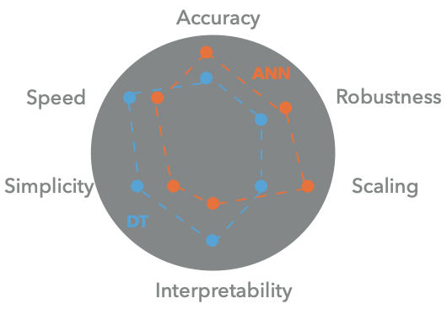
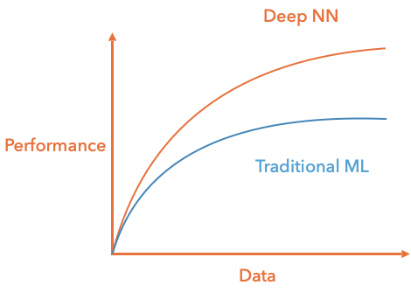
Classical/deep methods
Classical: linear regression, trees etc..
Deep: neural network type models

Slide 4
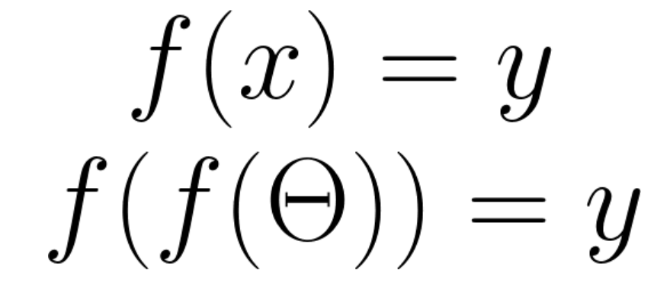
Deep learning as representation learning
“Hand-crafted” features
Classical ML
Deep learning
Unstructured data

Slide 5


Deep learning as representation learning
Traditional ML relies heavily on feature engineering before learning
Deep learning learns the features as well as the relational model of interest
Deep learning requires less manual input; but more data
Deep learning
Classical ML
Number of eyes
Whiskers
Legs
Fur
Scales
Number of eyes
Whiskers
Legs
Fur
Scales
Number of eyes
Whiskers
Legs
Fur
Scales
Classification model
cat

Slide 6
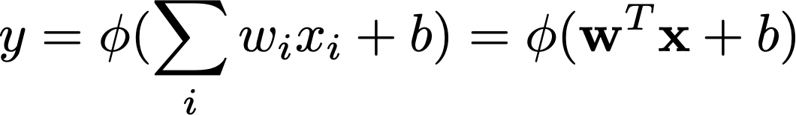
Neural networks
Early NN
Originally a device
Intended for binary classification
Produces a single output from a matrix of inputs, weights and biases

Slide 7

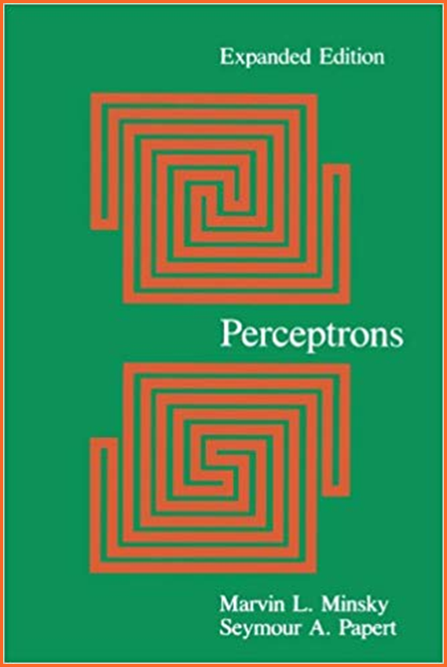
Neural networks
Single layer
Minsky and Papert showed they could not solve non-linear classification

Slide 8
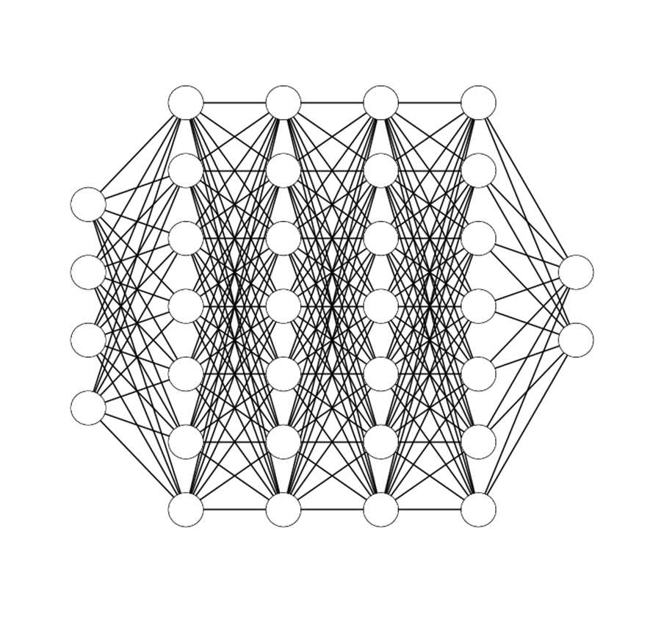
Neural networks
Back propagation
Now gradients could be used to minimise error
Modifications back propagate through the network using the chain rule

Slide 9
Deep neural networks: Multi layer perceptron
Input layer
Output layer
Hidden layers

Slide 10
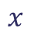
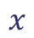
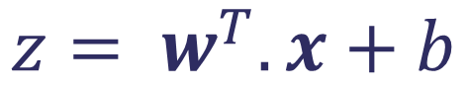
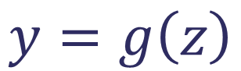
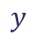
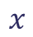
Dense layers
Also called fully connected layers
Activation function
$$x$$
$$y=g\left(z\right)$$
Output signal
$$x$$
$$y$$
$$z= w^{T}.x+b$$
Bias
$$x$$
Weights
Input signals

Slide 11
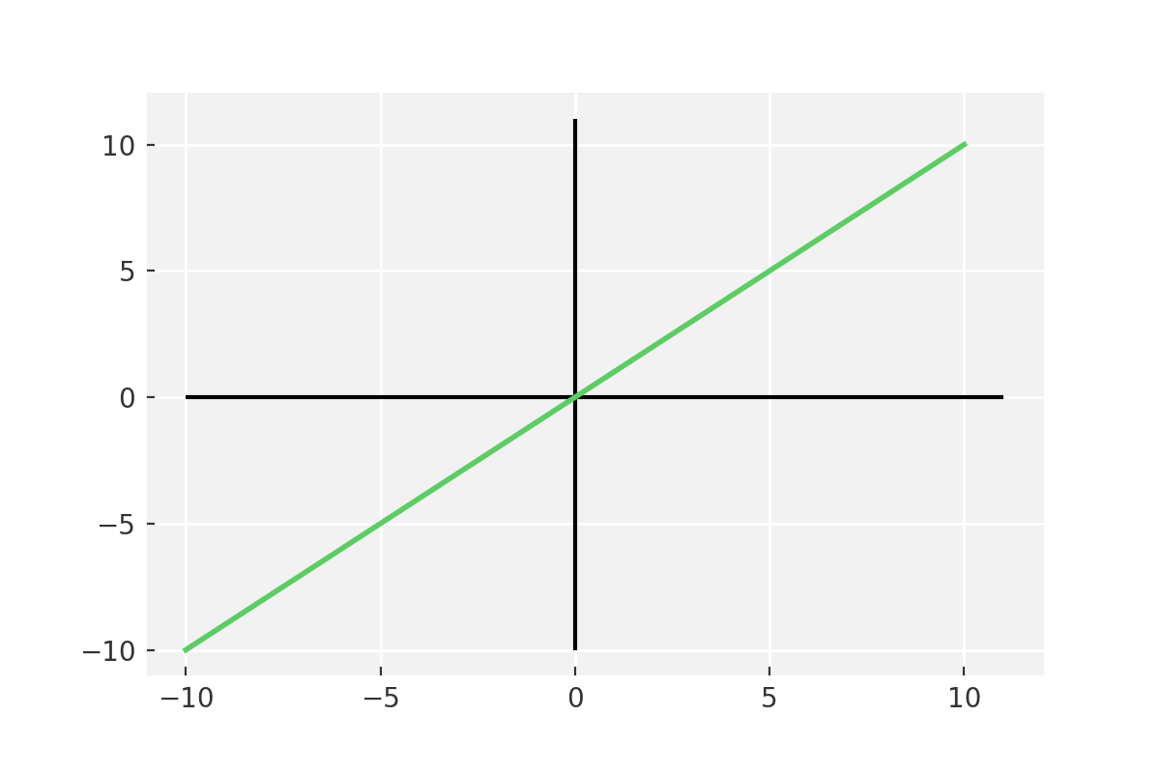
Activation function: Linear
The simplest form of activation function

Slide 12
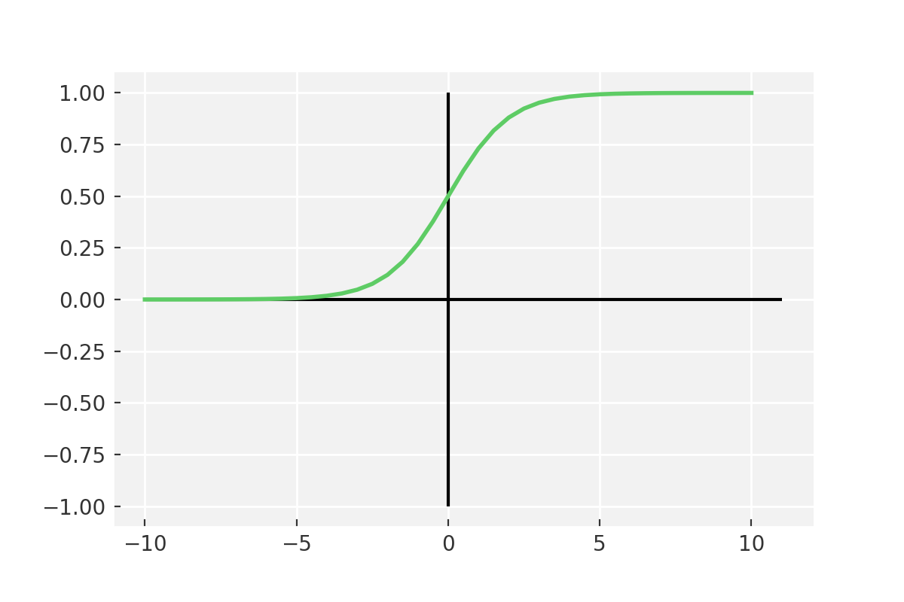
Activation function: Sigmoid
Vanishing gradient problem
Secondly , its output isn’t zero centered. It makes the gradient updates go too far in different directions. 0 < output < 1, and it makes optimization harder.
Sigmoids saturate and kill gradients.
Sigmoids have slow convergence.

Slide 13
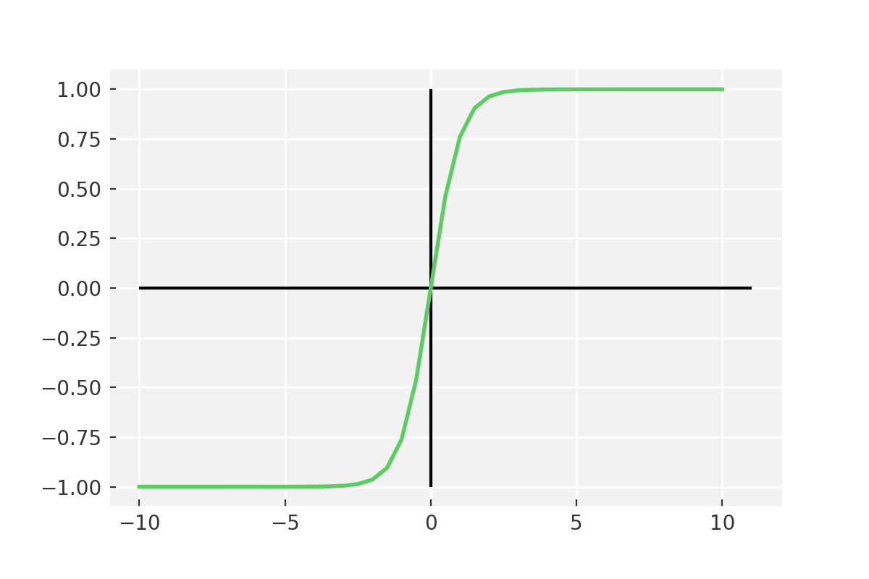
Activation function: Tanh
Output is zero centered
Usually preferred to sigmoid as it converges better
Still it suffers from vanishing gradient problem

Slide 14
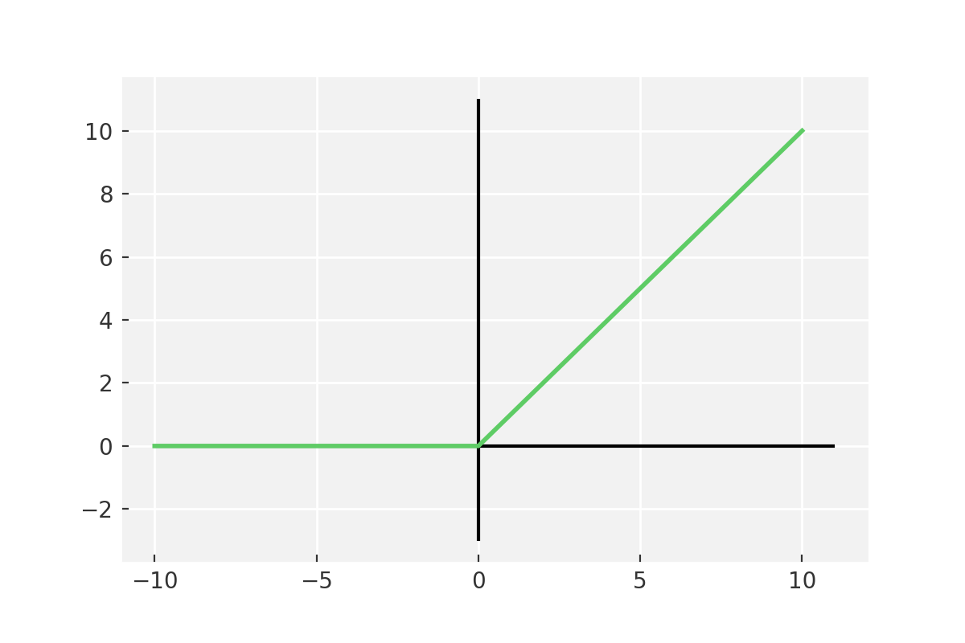
Activation function: ReLU
6 times improvement in convergence from Tanh function
Should only be used within Hidden layers of a neural network model

Slide 15
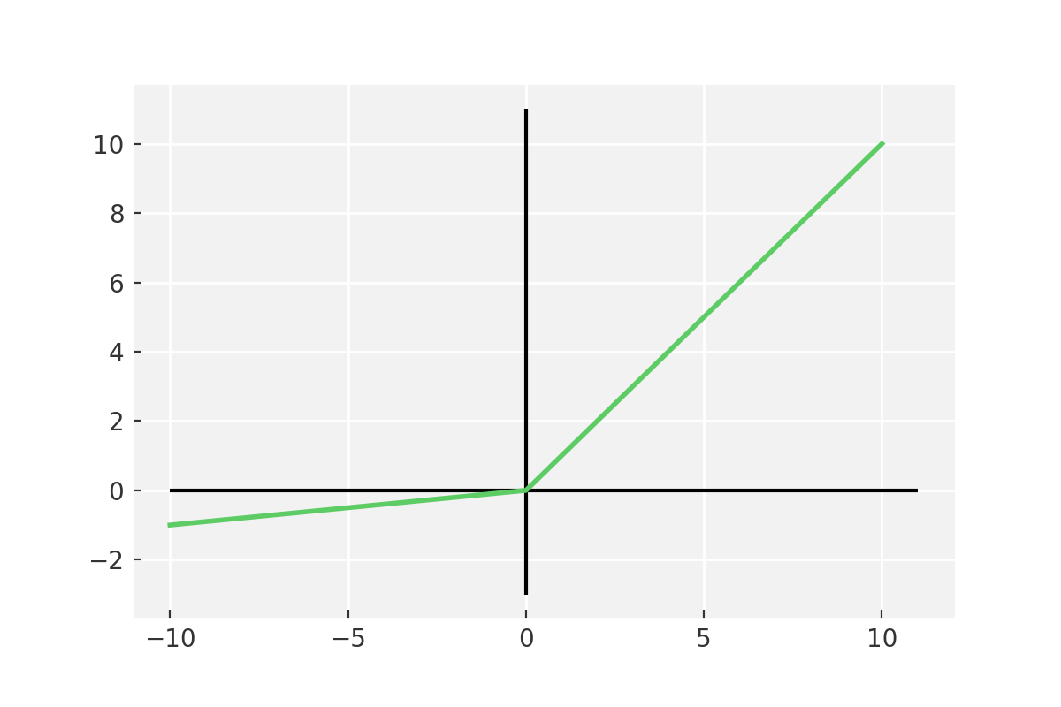
Activation function: LeakyReLU
Some ReLu gradients can be fragile during training and can die.
Cause a weight update which will makes it never activate on any data point again.
ReLu could result in Dead Neurons.
keras.layers.LeakyReLU(alpha=0.3)

Slide 16
Writing a DNN in PyTorch
class MLP(nn.Module):
def __init__(self, input_dim, output_dim):
super().__init__()
self.input_fc = nn.Linear(input_dim, 250)
self.hidden_fc = nn.Linear(250, 100)
self.output_fc = nn.Linear(100, output_dim)
def forward(self, x):
batch_size = x.shape[0]
x = x.view(batch_size, -1)
h_1 = F.relu(self.input_fc(x))
h_2 = F.relu(self.hidden_fc(h_1))
y_pred = self.output_fc(h_2)
return y_pred, h_2
Go to notebook

Slide 17
Back Propagation
Notation:
dL/dy[l] => dy[l]
Backprop
y[0]
y[1]
y[2]
y[l]
Loss(L)
dw[1]
db[1]
dw[2]
db[2]
dw[l]
db[l]
dy[l]
dy[1]
dy[2]

Slide 18
Optimisation
First order
Minimise the gradient of the loss function with respect to the parameters
Relatively quick, but ignores curvature
Second order
Calculate the second derivative of the loss function with respect to parameters
Slower per step, but includes curvature so can be quicker overall

Slide 19
Optimisation Stochastic gradient descent
Gradient descent – calculate the gradient of the loss of the entire set with respect to parameters
SGD – calculated per sample rather than on the entire batch
Much quicker to calculate, but can lead to high variance
Mini-batch SGD – calculate loss gradient on batches of set size
Best of both worlds

Slide 20
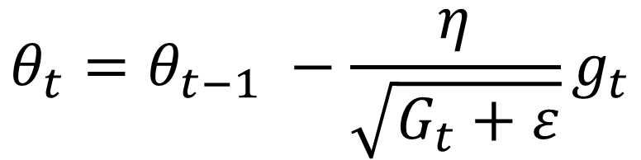
Optimisation: Adaptive methods
Some parameters update much more often than others
Therefore different learning rates can be appropriate for different parameters
Adagrad modifies the learning rate η at each time step for every parameter based on the past gradients computed for that parameter
Current gradient
Old parameter
New parameter
$$θ_{t}=θ_{t−1} −\frac{η}{\sqrt{G_{t}+ε}}g_{t}$$
Sum of previous gradients

Slide 21
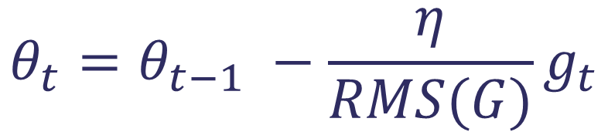
Optimisation: AdaDelta
Adagrad suffers because the gradients from all previous steps are accumulated, so the learning rate continuously decays
AdaDelta circumvents this by storing gradients only from n previous steps
Old parameter
New parameter
Current gradient
$$θ_{t}=θ_{t−1} −\frac{η}{RMS(G)}g_{t}$$
RMS of n previous gradients

Slide 22
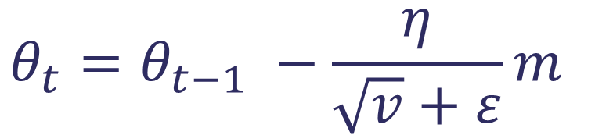
Optimisation: Adam
Similar to AdaDelta
Add in information about the mean of the momentum of previous steps too
Works very well in most situations
Mean of last n gradients
Old parameter
New parameter
$$θ_{t}=θ_{t−1} −\frac{η}{\sqrt{v}+ε}m_{}$$
Variance of last n gradients

Slide 23
Building block: Adam optimizer
import torch.optim as optim
optimizer = optim.Adam(model.parameters())
criterion = nn.CrossEntropyLoss()

Slide 24
Building block – a training loop
def train(model, iterator, optimizer, criterion, device):
epoch_loss = 0
epoch_acc = 0
model.train()
for (x, y) in tqdm(iterator, desc="Training", leave=False):
x = x.to(device)
y = y.to(device)
optimizer.zero_grad()
y_pred, _ = model(x)
loss = criterion(y_pred, y)
acc = calculate_accuracy(y_pred, y)
loss.backward()
optimizer.step()
epoch_loss += loss.item()
epoch_acc += acc.item()
return epoch_loss / len(iterator), epoch_acc / len(iterator)
Go to notebook

Slide 25
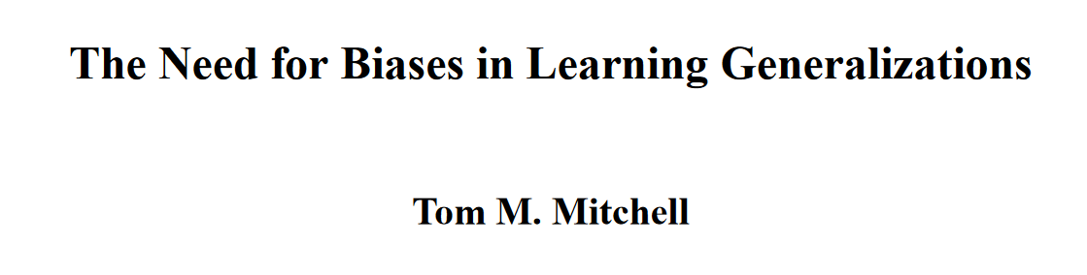
Convolutional Neural Nets: The power of inductive bias
The inductive bias (also known as learning bias) of a learning algorithm is the set of assumptions that the learner uses to predict outputs of given inputs that it has not encountered.
The need for biases in learning generalizations, CBM-TR 5-110, New Brunswick, New Jersey, USA: Rutgers University

Slide 26
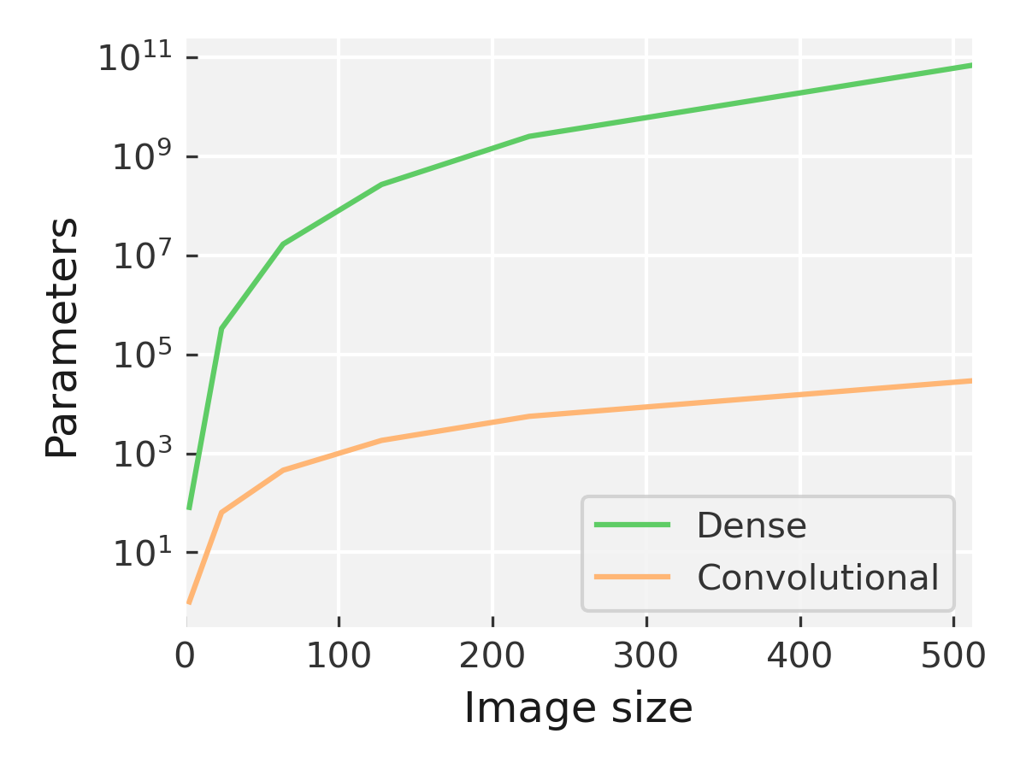
Some pitfalls with MLPs for images
No spatial awareness
Parametric explosions

Slide 27
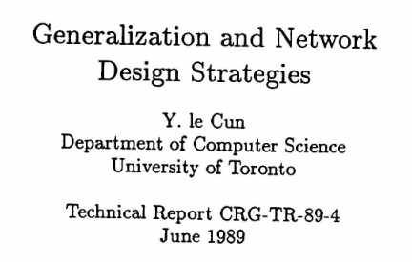
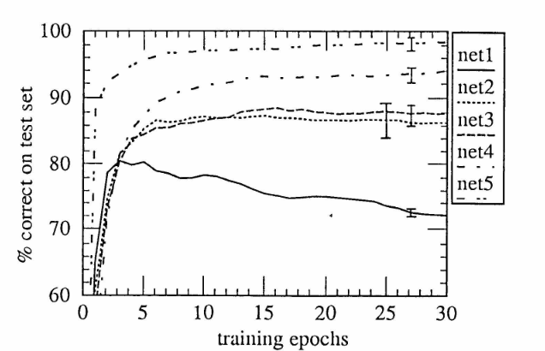
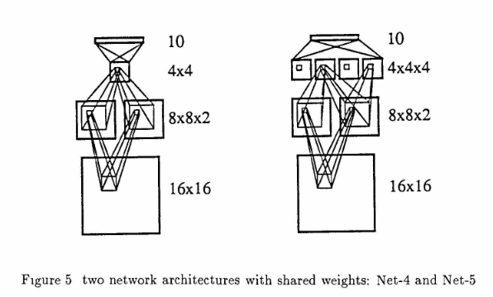
Early CNNs
LeCun – restricting the number of parameters in a NN leads to better generalisation
Also makes it possible to fit in memory
Originally trained for digit recognition for the postal service

Slide 28
Structure of a convolutional layer
Kernel
Pooling
Activation

Slide 29
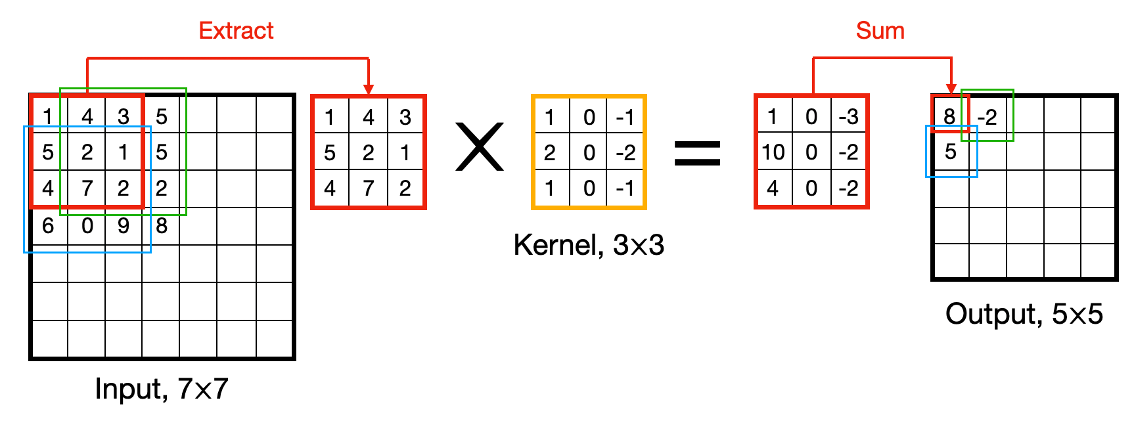
Convolution in action: Kernel
Input + kernel -> activation map

Slide 30
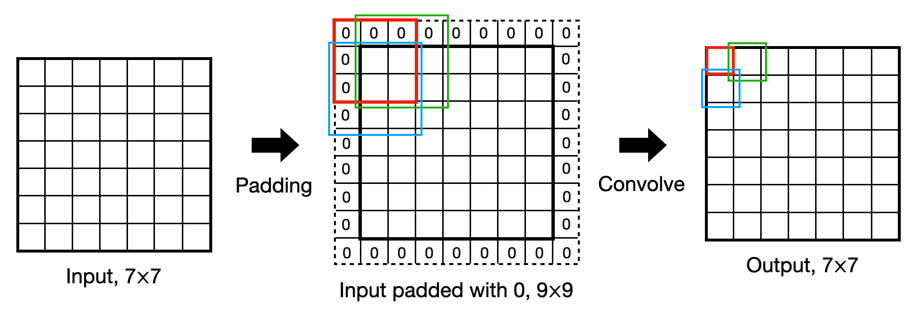
Convolution in action: Padding
Padding around the outside of images
SAME: pad with zeros to make output.shape == input.shape
VALID: no padding output.shape < input.shape

Slide 31
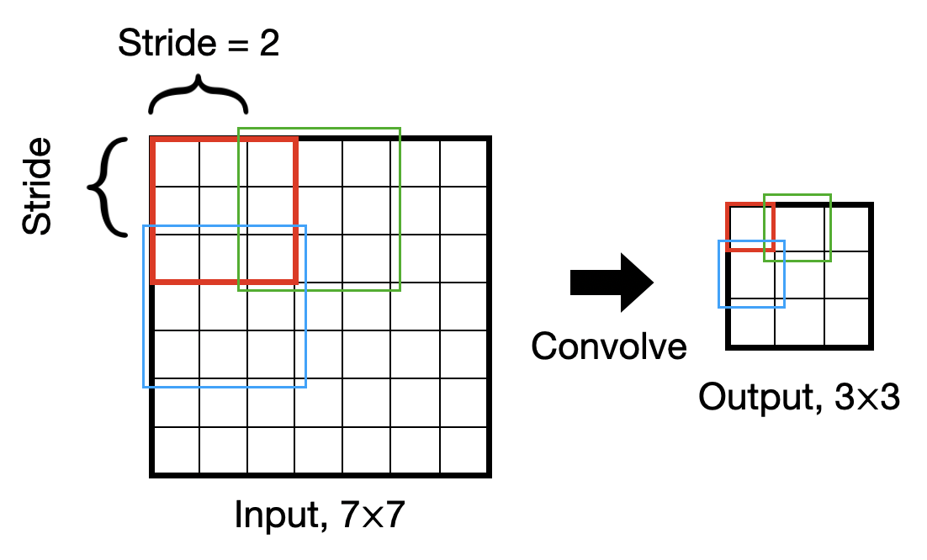
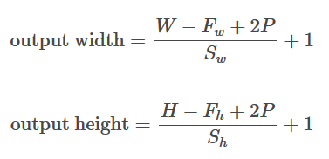
Convolution in action: Striding
Controls how the filter slides across the image

Slide 32
Convolution in action: Pooling
Use to compress between layers
3
1
7
2
5
1
0
9
Max Pool (2, 2)
5
9
8
2
4
9
8
9
4
3
1
1

Slide 33
Convolution in action: Putting it together
Input image – 1 channel
Activations – 3 channels
Output – 3 channels reduced dimensions
Activation function
Max pooling
3 filters

Slide 34
A deep CNN
(224, 224, 64)
(112, 112, 128)
VGG-16
(56, 56, 256)
(28, 28, 512)
(14, 14, 1024)
(w, h, c)
Conv + ReLU
Max Pool
Fully connected (dense) layer

Slide 35
Building blocks: Convolution block
import torch.nn as nn
self.conv1 = nn.Conv2d(in_channels=1,
out_channels=6,
kernel_size=5)
Go to notebook
import torch.nn.functional as F
x = self.conv1(x)
x = F.max_pool2d(x, kernel_size=2)
x = F.relu(x)

Slide 36
Key concepts
Deep learning is a qualitatively different process to classical ML
Deep learning generally requires more data than classical ML
Deep learning relies on representation learning
How to write and train a neural network in PyTorch
Inductive bias allows us to construct more general models
Inductive bias can allow us to use deep learning on smaller datasets successfully

